Slide 1

‘Super - Simple - Static - Sustainable’ a low resource repository jam
Progress Report
2024-06-06
Open Repositories 2024, Göteborg, Sweden. June 2 - 6, 2024.

Slide 2
Workshop core values and aims
THIS IS NOT A COMPETITION.
We will encourage participants to learn new skills and to work with new collaborators and create teams with a diverse range of background and levels of experience
Produce demonstrable code/techniques for creating, managing and disseminating simple static repositories / archives with real data (where possible) that can immediately be used in low resource environments
But it might be a *bit* like the old OR “Developer Challenge”
We will recap the inspiration for this session, present & discuss Suleman’s “principles and design goals”:
Simplicity/Minimalism – only as much system as needed
No imposition on users – no logins unless necessary
No Internet - should work even when offline
Simple preservation – as simple as copying files
Flexibility in objects/services – no arbitrary restrictions
Superimposed and hierarchical information – because we understand this
Platform agnosticism – any OS, any hardware
Pre-processing – fewer cycles needed when live
https://zenodo.org/records/8111569
Inspired by the rousing OR-2023 closing keynote
Notes:
Inspired by Prof Hussein Suleman’s closing keynote at OR2023 “Designing Repositories in Poor Countries” this workshop explored practical implementations of Suleman’s principles and goals. We encouraged developers, metadata specialists and managers to embrace, simple and sustainable approaches to making data safe and available using well established static web publishing techniques with on-demand indexes and discovery interfaces – contrasting with the complexity of current repository stacks which have grown into bloated enterprise software where setup and data migration are very expensive and hosting requirements are substantial.
We explored a range of technologies including those mentioned in the keynote and the participants came up with the following ideas which they’ve been working on and documenting throughout the conference.
We’d love to see some of these ideas continue to develop and to show up at OR2025 as poster or dev-track submissions.

Slide 3
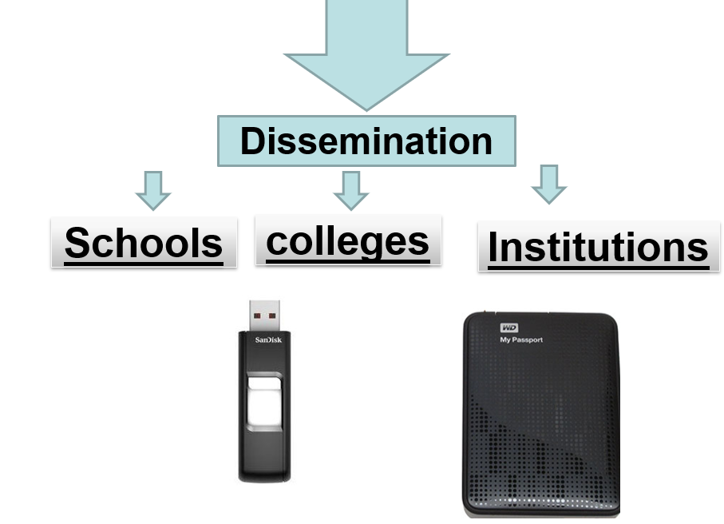
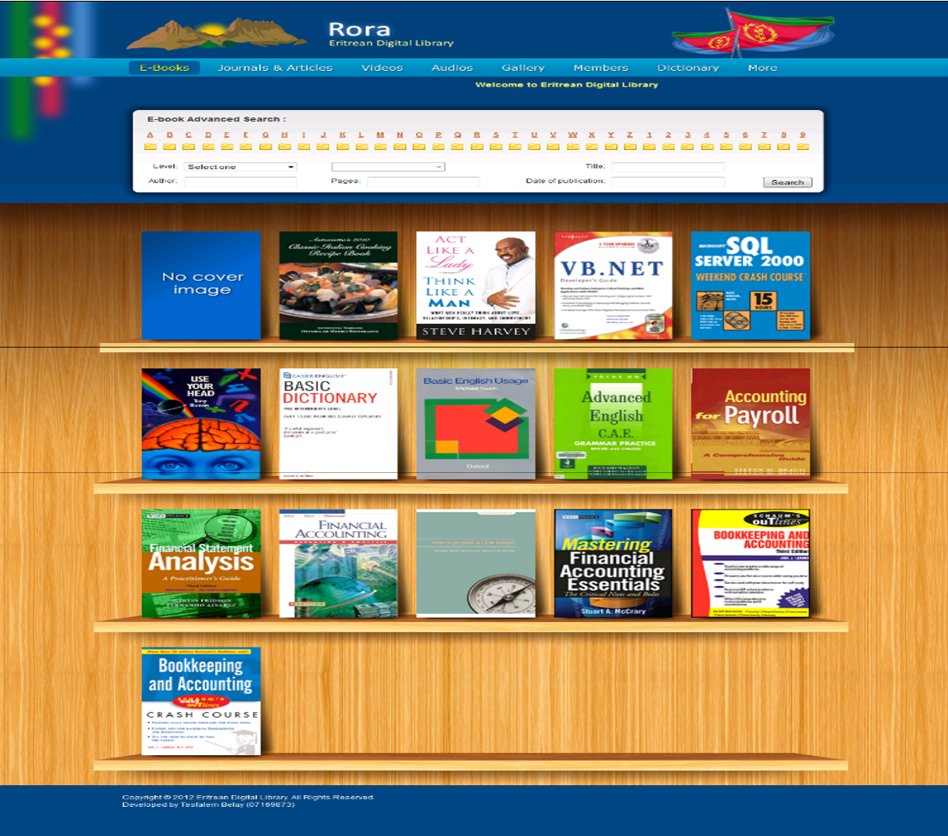
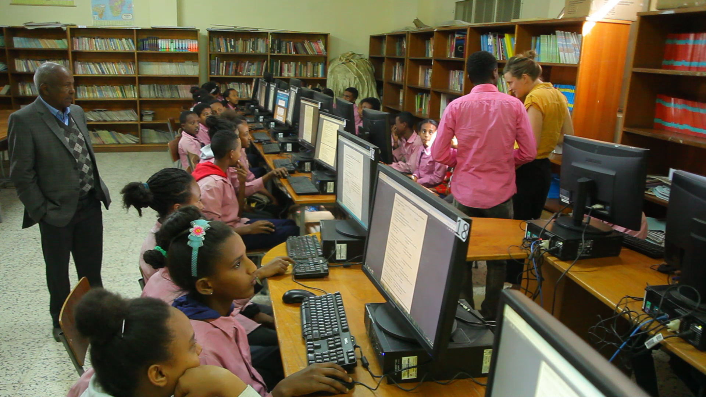
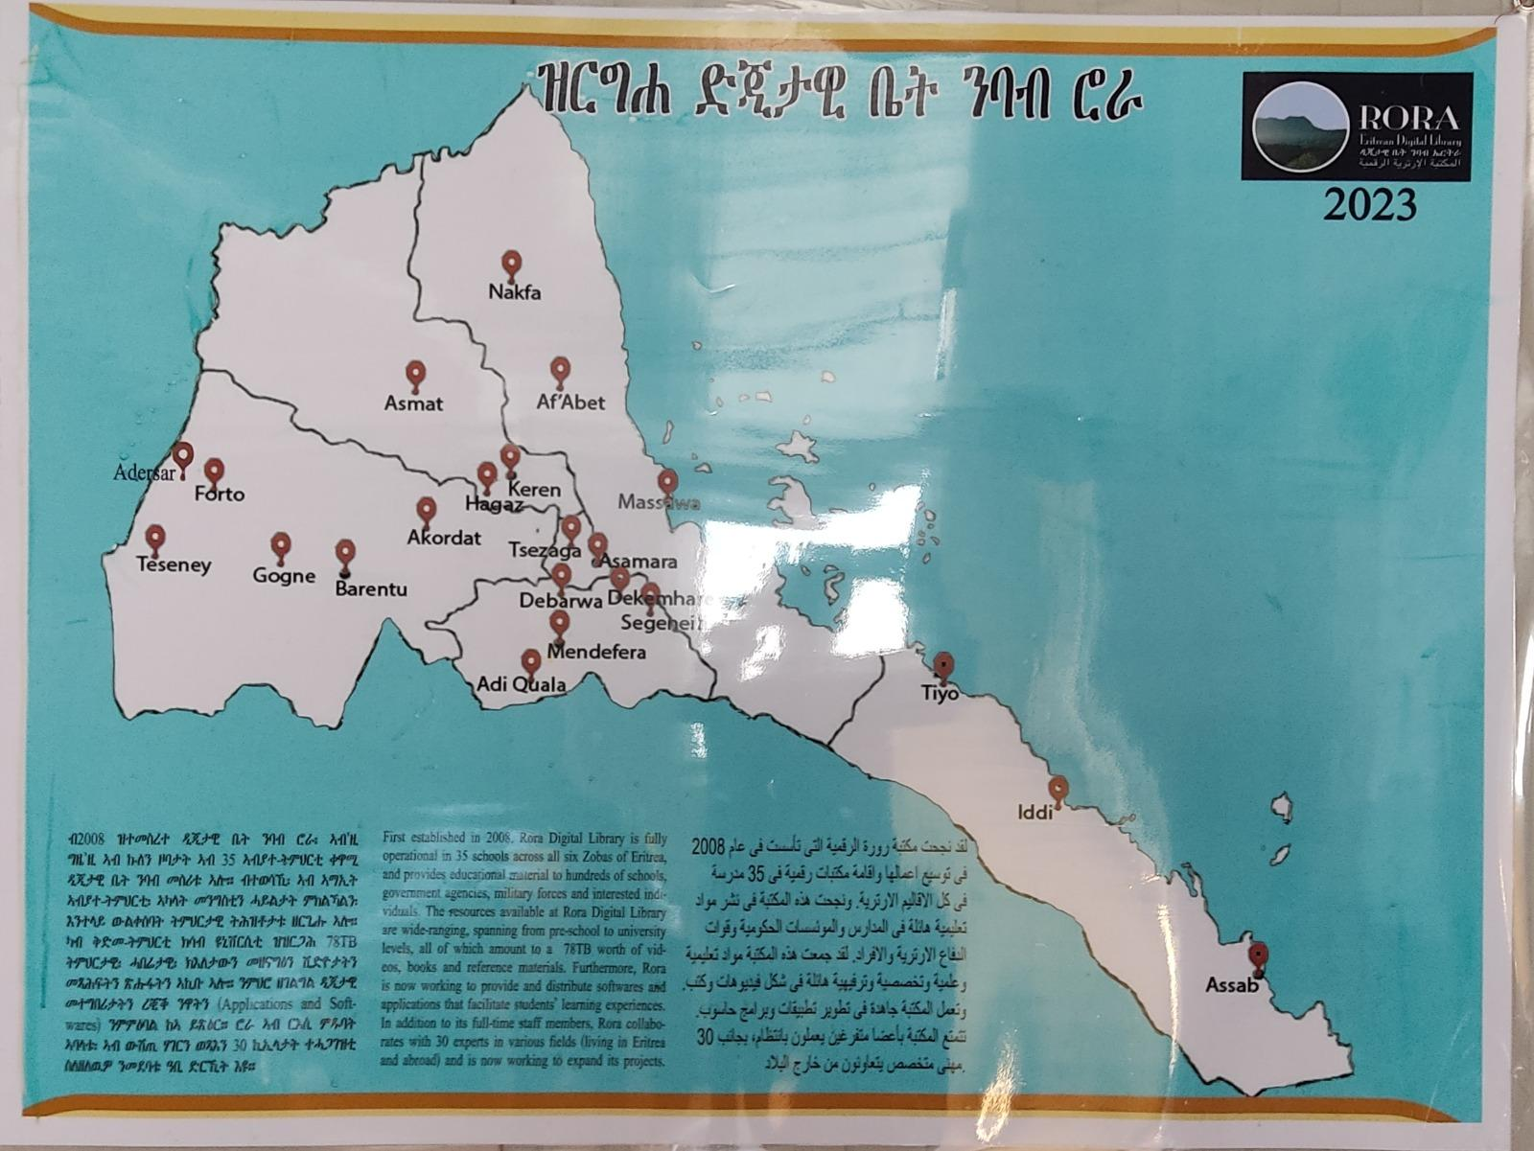
Internet in a Box
3. Solution
Low End Server
A router or Access point 50 users
Website
Content
Communities in Diaspora
1. Context
Population 3.8
Schools > 1400
Students 600,000
Conventional Library costly
Internet penetration below 1%
2. Problem
Difficult to provide info
4. Result

Slide 4

Easy Open
A user-friendly top level organization for self-contained browsable packages
Patrick Stickler, Peter Sefton, …
OPEN.html #Required
content/ #Required
metadata/ #Optional
resources/ #Optional
OPEN.html # redirects to content/ro-crate-preview.html
content/
ro-crate-metadata.json
ro-crate-preview.html
ro-crate-preview_files/
…
bag1/
bagit.txt
bag-info.txt
manifest-sha512.txt
data/
example.txt
metadata/
manifest.txt
# content/ro-crate-metadata.json
# content/bag1/bag-info.txt
Notes:
Easy Open is a concept / proposal for a simple, maximally clear, user-friendly top level organization for providing self-contained browsable archives, repositories, datasets etc. which is compatible with the broadest range of existing packaging and metadata standards (but requires none).
The key goal of this proposed standardized top level organization is to make it as clear and easy as possible for a user to begin to consume the contents of a package without having to understand anything about the underlying packaging or metadata solutions used to organize and describe it, while also being compatible with existing and future standards and conventions for providing rich metadata and well organized and portable structure, enabling automated consumption by tools.
Easy Open focuses exclusively on the top level organization of user friendly, easily consumable, browsable, and platform portable content, and is a component of developing recommendations for producing maximally distributable and consumable packages of content, including
operating system and filesystem agnostic
compatible with commonly used web browsers, including text-only and no-javascript environments
Javascript and stylesheets can be used to make the browsing experience more dynamic and richer, but it is recommended that such functionality not be critical to consuming the core content of the package and that users aren't prevented in any significant way from consuming the content without Javascript or stylesheet support
self-contained and consumable offline
minimal run-time resource requirements
all content should be as accessible as possible
Follow the QR code link for more details and examples.

Slide 5
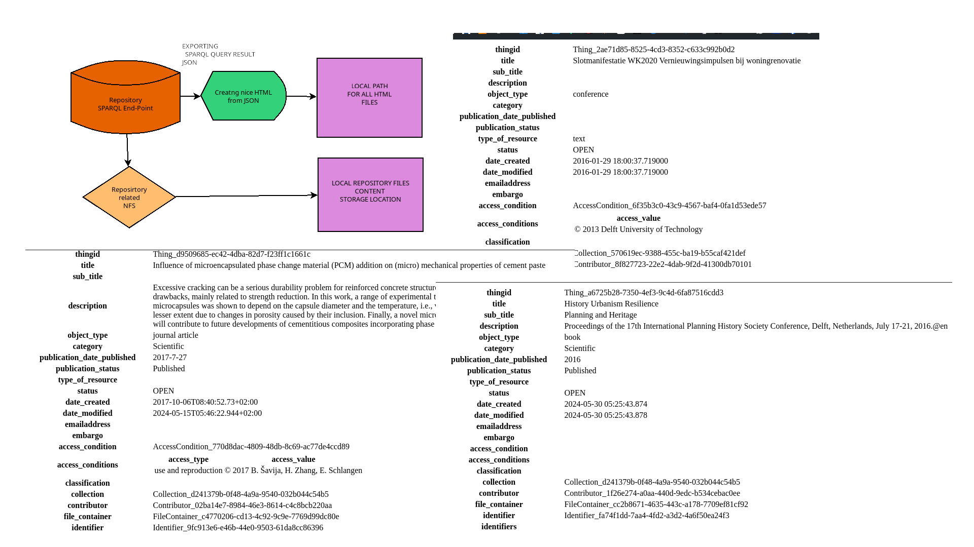
Generating Static repository from the Dynamic one
(Mahsa and Andjela)

Slide 6
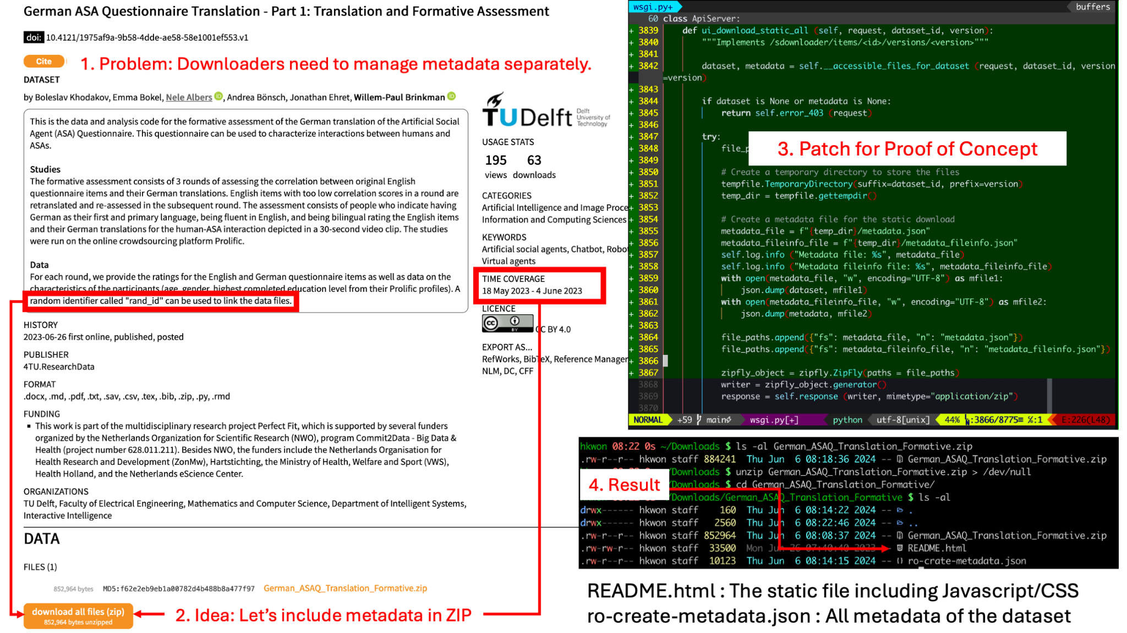
Simple export of Zip + HTML in Easy Open Format | Hyeokjin Kwon (TU Delft / 4TU.ResearchData)

Slide 7
EPrints to Easy Open static export
Here’s last year’s slides… (sorry Rory ;) Actually, here’s a SVN commit:
~/tools/static_site.pl Rev 7182 – 4607 d 19 h (Monday 24th October 2011) Author: tdb01r (Tim Brody) Log message: * experimental tool to generate a static version of an EPrints repository
Started enhancing it to output the site in EasyOPEN as previously described.
Outputs an EPrintsXML metadata file, thumbnails, documents, browse views
Browser-based search using Lunr.js https://lunrjs.com/ A bit like Solr, but much smaller and not as bright.
Notes:
So, it turns out EPrints started work on this topic approximately 4610 days ago. None of us had actually run it. We have now. It still works, and outputs a static browseable site, thumbnails, content. So we broke it whilst trying to make it output a site in the EasyOPEN format previously described. Can output static metadata file in a variety of formats (e.g. DC, JSON)

Slide 8





EasyScrape: ‘Remote site generation’ (impl. Easy Open)
Kim Shepherd, Kiflom Michael Kahsay, Marco Schirone
Publish local content on Internet
No Internet?!
Crawler + generator + storage + friend with Internet =
Distribute offline repo
Host ‘online’ stuff locally
Spiders for feeds:
OAI-PMH, RSS, Atom
Crawl/harvest repo, output static stuff
Markdown (readable, usable, site generators like it)
Resources (PDFs, data, images)
Generate site
Jekyll
11ty
Pelican
Host Internet content locally
EasyOpen, OCFL, Bagit..
Open Repositories 2024, Göteborg, Sweden. June 2 - 6, 2024.
Notes:
You already heard the use case: Eritrea has no reliable Internet, so they rely on physical storage to send and receive Internet content from nearby regions with more reliable Internet. They run research repositories on their local networks, and caching proxy devices to serve some open educational content as if it were ‘online’.
Our tools use projects with large, active communities, common standards (including new one!), and practical considerations to get local research outputs out onto the Internet in the form of standalone, simple websites, and can also gather useful open resources from the Internet and package it in a way that can is simple to feed into devices like RACHEL Plus or host in local intranet webservers.
We started our prototyping by harvesting OAI-PMH METS feeds from DSpace and EPrints repositories and producing HTML with XSLT as well as markdown frontmatter to feed into more fully-featured site generators like Jekyll, 11ty, Pelican.

Slide 9
https://github.com/OpenRepositoriesConference/Super-Simple-Static-Sustainable

